Slide 1

Project Work External Review
Prediction Of Lung Disease(Pneumonia) Using Deep Learning
Team Members:
A.T.V Satya Sai Rohit: 16951A05M4
K. Vinay Kumar: 16951A05N7
T. Chandana: 16951A05K1
Supervisor:
B. Padmaja
Professor of CSE
Computer Science And Engineering
Institute of Aeronautical Engineering
(Autonomous)
Dundigal, Hyderabad – 500043.

Slide 2
INTRODUCTION
Deep learning algorithms can be used in the medical field. One such application is detecting lung disease like pneumonia using chest x-rays.
Many deep learning algorithms can be used to perform the task.
So, here we are using a pretrained network known as VGG 16 of transfer learning which provides state of the art algorithms which classifies different kinds of images.
So, the aim is to build a model by training it with several sets of images classified into pneumonia and normal ones. Finally, the model will be able to predict the occurrence of pneumonia disease from chest x-rays with better accuracy.

Slide 3
STATEMENT OF THE PROBLEM
Predicting Pneumonia is done through chest x-rays by considering various factors in the x-ray by radiologists. A deep learning model can be build and can be trained with these x-rays which can predict the pneumonia.However building CNN’s i.e new deep learning neural network is not so feasible and requires lot of parameters and datasets to be trained with.
However a pretrained model like VGG 16 trained on imageNet can be utilized to solve this problem.
This report presents one of the accurate model to solve the problem of the prediction.

Slide 4
SIGNIFICANCE OF THE RESEARCH
There were existing systems which utilized some machine learning Extreme Learning algorithms(ELM and OS-ELM) which is an artificial neural network which takes the advantages of both deep learning and extreme learning machines but the accuracy obtained was not up to the mark.
Even some deep learning techniques involved building of CNN models by using custom hyperparameters which are not very helpful.
Deep neural networks have demonstrated high levels of accuracy in the fields of image classification when transfer learning framework is used.

Slide 5
SIGNIFICANCE OF THE RESEARCH
Pre-trained deep CNNs with sufficient training provide a performance better than training a CNN from scratch.
Transfer Learning provides state of the art algorithms, so we need not train weights in the back propogation.
Using pre trained networks offer an efficient way of building a model and can offer good accuracy ranges of greater than 90% based on the layers.

Slide 6
LITERATURE REVIEW
Observations | Reference
Deep Learning has a larger scope in the field of medical science and radiology. | [2]-[5]
The analysis of chest radiography has a vital role in the field of medical science and radiology. | [5]
CNN's proved to be the best algorithms for image classification. | [6],[7]
Using standard architectures in transfer learning like VGG 16 we can explore various pooling and flattening operations. | [8]
When pre trained networks are utilized the results accuracy was found to be more promising. | [10]-[12]
Lung Diseases are the most common type of diseases | -
Deep Learning is powerul with high processing and many applications | -

Slide 7
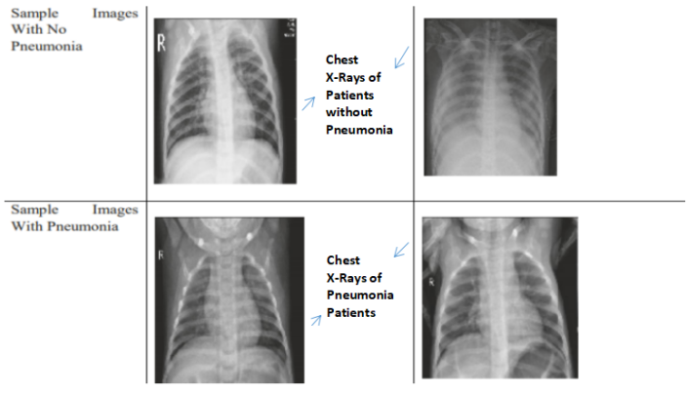
DATA COLLECTION
Approximately 5000 X-ray images of anterior-posterior are used to experiment which are publicly available on data collection platform known as kaggle.
The original dataset mainly consists of three folders they are - training, testing, and validation. In addition to these, it contains two subfolders that contain pneumonia (P) and normal (N) chest X-ray images, respectively.
[Fig 1. Sample X-rays from Dataset]

Slide 8
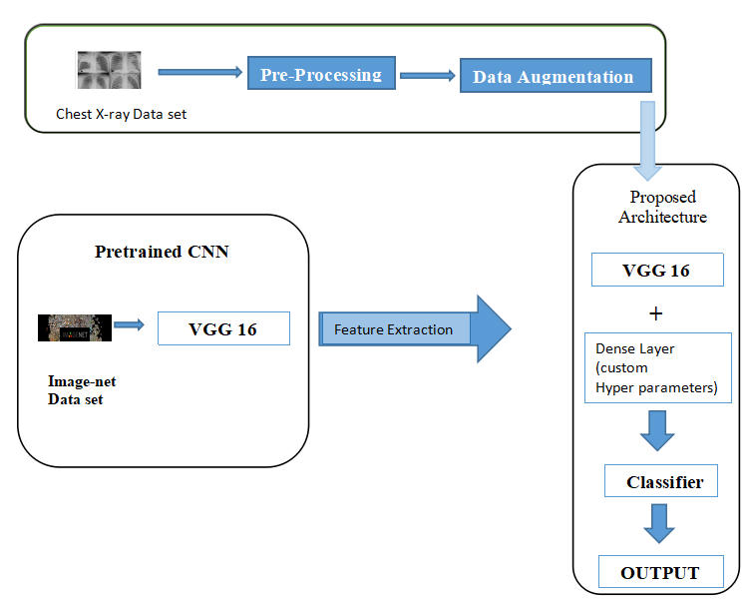
BLOCK DIAGRAM
[Fig 2. Block Diagram of the Proposed System]

Slide 9
METHODOLOGY
Keras open-source deep learning framework is deployed with TensorFlow backend to build and train the convolutional neural network. Relu Activation Function is used in the convolutional operations. Softmax Activation Function is used at dense and fully connected layers to fit the model accurately. Adam Optimizer is used with different iterating learning rates to optimize the model.
The VGG 16 model consists of a combination of pre-trained weights, convolutions, poolings, and fully connected layers. Convolution operation uses different filters with different values to detect different aspects of the image like vertical edge detection, horizontal edge detection, face edges, etc.

Slide 10
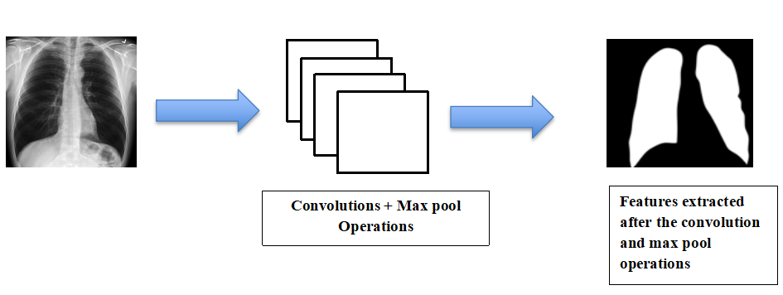
METHODOLOGY
Max pooling layer is used to select the high-intensity values from the previously trained image. A visual representation of the working can be seen in the below figure.
[Fig 3. A visual representation of convolution and max pool operations]

Slide 11
METHODOLOGY
The first convolution operation is performed two times with input shape as (224,224,3) and the output resulting shape is of (224,224,64) .
The next step in the model consisted of a max pool operation with input shape of (224,224,64) and resulting in an output shape of (112,112,64).
Then again two convolution operations are performed with input shape (112,112,64) and resulting output shape is in the order of (112,112,128).
The second max pool operation is performed which resulted the output shape of (56,56,128) from an input of (112,112,128).

Slide 12
METHODOLOGY
Next again the model is further built by performing 3 convolution operations with a resultant output shape of (56,56,256) when (56,56,128) is considered as input shape.
Then max pool operation is performed for the third time with input shape of the image (56,56,256) resulting in an output shape of (28,28,256).
There after three convolution operations are performed taking an input shape of (28,28,256) and resulting in an output shape of (28,28,512).
The fourth max pool operation is performed with resulting shape of (14,14,512).

Slide 13
METHODOLOGY
Then again 3 convolutions operations are performed with input shape (14,14,512) resulting in output shape (14,14,512). The last max pool operation is performed with resulting shape of (7,7,512).
The last layer is flatenned and dense layer should be added. Here softmax activation function should be used.
This is all about the model involving accurate pre-trained neural networks. The results and performance are discussed in the upcoming sections.

Slide 14
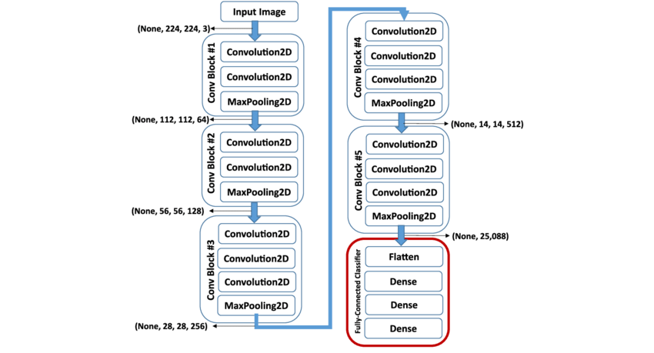
METHODOLOGY
Flow Chart For Proposed System

Slide 15
ALGORITHM PROCEDURE
Importing the VGG 16 model and other necessary libraries from Keras should be done.
The images in the data set should be re sized to [224,224] with 3 color channels.Then the training paths and testing paths along with validation paths are need to be set up.All the training paths and validation paths should be provided and stored.
All the training paths and validation paths should be provided and stored.
The top layer of the imported VGG 16 should be removed and Pre-processing layer should be added to the front of VGG and the weight should be same as those to image net.

Slide 16
ALGORITHM PROCEDURE
The existing weights of the VGG 16 should not be trained again.The existing weights itself are to be used.The last layer is flatenned and dense layer should be added. Here softmax activation function should be used.
Then model object should be created where inputs are from vgg and outputs prediction is based on binary classification i.e normal and pneumonia (0 and 1 respectively).The cost optimization and loss function are applied to the model.The loss function used is ‘categorical_crossentropy’ and optimizer used is ‘adam’.
Various sets of images should be created using data augmentation using ImageDataGenerator
Finally the model should be fitted. Number of epochs should be preferably set to 5 or more.
Plotting the loss function and accuracy is done finally.

Slide 17
RESULTS AND DISCUSSIONS
The proposed model used the hyper parameters of the pre trained model of VGG 16. The last dense layer was modifies to suit a binary classifier. The model was constructed and tested with various kind of input images.
The data sets consists of images which include pneumonia and normal ones.About 3,722 images were assigned to the training set and 2,134 images were kept in the validation set.
The distribution of images in to the categorical classes is done on a balanced level while those consisting of pneumonia images were given additional images and scope. The distribution of images for training in to the categorical classes can be seen in Figure below.

Slide 18
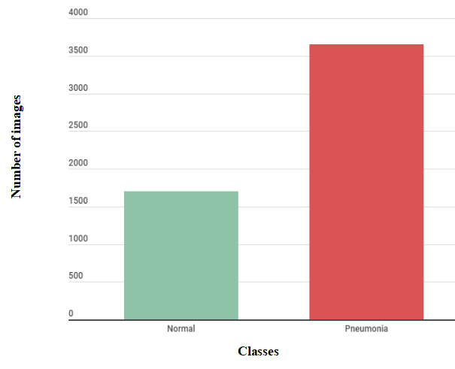
RESULTS AND DISCUSSIONS
[Fig 4. Class distribution of data sets]

Slide 19
RESULTS AND DISCUSSIONS
The model has been generated with the following parameters which can assist in achieving the aim of the proposed system.The model is stacked with various layers and output is modified and adavances forward to achieve the desired result of accurately training the model by extracting all the features in a well balanced and discriptive manner.
The model generated has 14,764,866 params out of which 50,178 are trainable and 5219 images belonging to 2 classes are formed.The parameters with which the model has been generated can be seen in below figure.

Slide 20
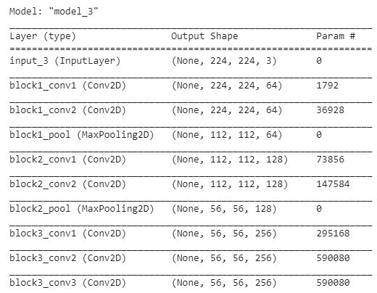
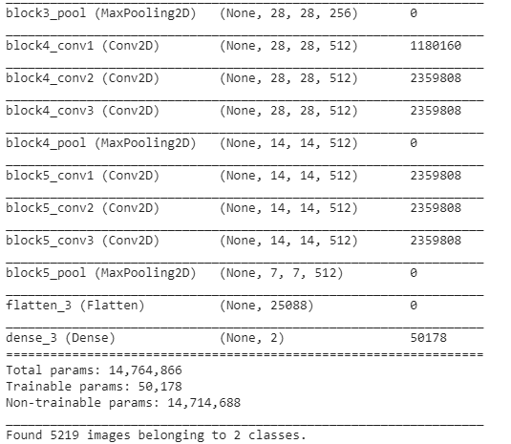
RESULTS AND DISCUSSIONS
[Fig 5. Model Description]

Slide 21
RESULTS AND DISCUSSIONS
To evaluate and analyze the performance of the proposed model, the experiments were conducted several times with different sizes of datasets.
However, different parameters were used to study performance. In this report, only the most valid and better approach is presented.
Even a large set of images require more training time as well as computational cost. Usually, CNN models require images of the same sizes during training and that's the reason why data sets of similar sizes are considered and resized to suit the constraints.

Slide 22
RESULTS AND DISCUSSIONS
In this way the model predicts the outcome based on the data. The input is set of images of fixed size (224,224) as the VGG 16 architecture is designed to accept the data in those parameters. Several results are obtained while trying to retain the best model and network parameters.
Many parameters were highly tuned to view the overall results. However this report only presents the valid experiments with accuracy, loss and validation values of the proposed model. Figures below shows the performance of the network.

Slide 23
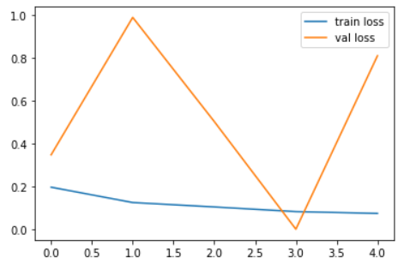
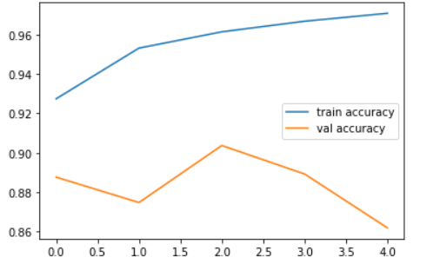
RESULTS AND DISCUSSIONS
[Fig 6. Plot for Accuracy]
[Fig 7.Plot for loss function]
Data Size | Training Accuracy | Validation Accuacy
5000 | 97.07% | 90.85%
Performance of the network

Slide 24
CONCLUSION
The proposed system has shown better accuracy and validation than existing systems as the novel concept of transfer learning framework in modelling our data sets is used.
The proposed model is highly effective in the diagnosis of pneumonia through chest x-rays and can be implemented easily with some good computing requirements showing a good amount of accuracy.
The results obtained are very much valuable and focuses on the opportunity that the training of deep neural networks in the medical field is a viable and good option as more number of public data sets are becoming available.

Slide 25
FUTURE STUDY AND LIMITATIONS
In the future, the model can be upgraded to even predict the type of virus and kind of various infections with the greater availability of open-source data sets of x-rays.
The proposed model is based on predicting the cause of pneumonia i.e binary classifier which categorizes two classes. However we can further train the pre trained network in such a way that it can be able to classify more type of infections and diseases like Infiltration, Atelectasis, Cardiomegaly, Effusion, Mass, Nodule, Pneumonia, Pneumothorax

Slide 26
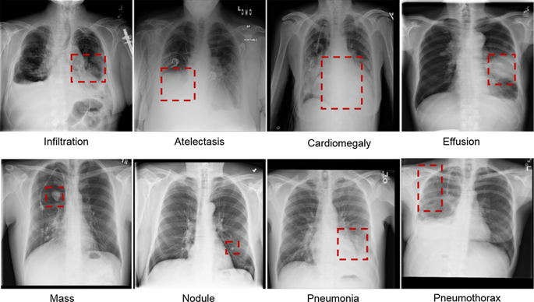
FUTURE STUDY AND LIMITATIONS
The proposed system requires large amount of data sets to perform accurately and perfectly validate it.
It is very computationally expensive to train and there are no defined ways in which one could choose the hyper parameters/ training method for a particular type of problem
[Fig 8. Future Study]

Slide 27
REFERENCES
[1]Vijendran, Sriram, and Rahul Dubey, "Deep Online Sequential Extreme Learning Machines and its Application in Pneumonia Detection," 8th International Conference on Industrial Technology and Management (ICITM),Cambridge, United Kingdom, United Kingdom IEEE, 2019
[2]Taylor, Andrew G., Clinton Mielke, and John Mongan, "Automated detection of moderate and large pneumothorax on frontal chest X-rays using deep convolutional neural networks: A retrospective study," PLoS medicine journal e1002697, November 20, 2018.
[3]Pan, Sinno Jialin, and Qiang Yang, "A survey on transfer learning," IEEE Transactions on knowledge and data engineering, pp. 1345-1359, 2009.
[4]Rajpurkar, Pranav, et al., "Chexnet: Radiologist-level pneumonia detection on chest x-rays with deep learning," arXiv preprint arXiv:1711.05225, December 25, 2017.
[5]TaPasa, F., et al., "Efficient deep network architectures for fast chest x-ray tuberculosis screening and visualization," Journal of Scientific reports, Volume. 9.1 (2019): 1-9, April 18, 2019.
[6]Poplin, Ryan, et al, "Prediction of cardiovascular risk factors from retinal fundus photographs via deep learning," Nature Biomedical Engineering 2.3 (2018): 158, February 19, 2018.
[7]Rawat, Waseem & Wang, Zenghui., “ Deep Convolutional Neural Networks for Image Classification: A Comprehensive Review,” Neural Computation, Volume 29, p.2352-2449, August 23, 2017.

Slide 28
REFERENCES
[8]Bharati, Subrato, and Prajoy Podder, "Disease Detection from Lung X-ray Images based on Hybrid Deep Learning," arXiv preprint arXiv:2003.00682 (2020), March 20, 2020.
[9]Manikonda, Santhosh KG, and Dattatraya N. Gaonkar, "A novel islanding detection method based on transfer learning technique using VGG16 network, " 2019 IEEE International Conference on Sustainable Energy Technologies (ICSET), IEEE, 2019.
[10] LYao, Peng, et al., "Fully hardware-implemented memristor convolutional neural network," Nature 577.7792 (2020) , pp. 641-646, January 29, 2020.
[11] Sahiner, Berkman, et al., "Deep learning in medical imaging and radiationtherapy," The International Journal of Medical Physics Research and Practice 46.1 (2019): e1-e36.A, October 26, 2018.
[12] Biswas, Mainak, et al, "State-of-the-art review on deep learning in medical imaging," Frontiers In Bioscience, Landmark, 24, pp. 392-426, Jan 1, 2019
[13] Baltruschat, Ivo M., et al., "Comparison of deep learning approaches for multi- label chest X-ray classification," Scientific reports 9.1 (2019): 1-10, April 23, 2019.

Slide 29
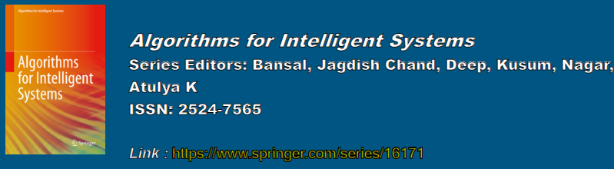
LIST OF PUBLICATIONS
Evaluation Of Deep Learning Models In The Prediction Of Lung Disease(Pneumonia)
Paper is Accepted and Registered for the following Conference :
“International Conference on Data Intelligence and Cognitive Informatics (ICDICI-2020) Springer Conference”
which is to be held on 8-9 July, 2020

Slide 30


